Slide 1
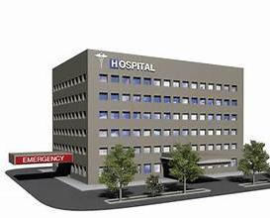
Comprehensive SQL Analysis of Hospital and Patient Data
Notes:
NOTE:
To change the image on this slide, select the picture and delete it. Then click the Pictures icon in the placeholder to insert your own image.

Slide 2
AGENDA OF MEETING
INTRODUCTION
AIM OF THE PROJECT
QUERIES
INSIGHTS
RECOMMENDATIONS
CONCLUSION

Slide 3
INTRODUCTION
OVERVIEW : This project focuses on analyzing hospital and patient data using SQL to extract meaningful insights. It involves calculating key metrics like average admission deposits, patient counts, and deposit trends by age and admission type. The analysis includes data transformation, identifying missing values, and ranking hospitals by performance.
OBJECTIVE : The objective of this project is to analyze hospital and patient data to uncover key insights, such as average admission deposits, patient distribution across hospitals, trends based on age and admission type, and data quality issues.
DATA SOURCE : The dataset used in this project consists of two tables: hospital.patient, which includes patient-specific information such as patient ID, age, type of admission, severity of illness, admission deposits, and city codes, and hospital.hospital(1), which contains hospital details like hospital codes, departments, and corresponding city codes. The data provides a comprehensive view of both patient demographics and hospital operations, enabling in-depth analysis of healthcare trends and performance.

Slide 4

TOOLS USED
MySQL Workbench is a tool that helps you work with MySQL databases easily. It provides a user-friendly interface to create, manage, and analyze databases without needing to type commands all the time.

Slide 5
Where did you get the data from ?
Got it from Open Source
Got it from Open Source

Slide 6
Aim of the project
The aim of this project is to perform a detailed analysis of hospital and patient data using SQL to extract valuable insights into hospital performance, patient demographics, and financial trends. By examining metrics such as admission deposits, patient counts, age group analysis, and admission types, the project seeks to identify patterns, improve data quality, and support informed decision-making in healthcare management.

Slide 7

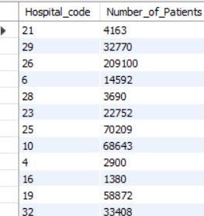
To get the number of patients in each hospital.
SELECT h.Hospital_code, COUNT(p.patient_id) AS Number_of_PatientsFROM `hospital(1)` h LEFT JOIN patient p ON h.City_Code_Hospital = p.City_Code_Patient GROUP BY h.Hospital_code;

Slide 8

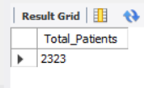
How many patient records are there in the dataset?
SELECT COUNT(*) AS Total_Patients FROM patient;

Slide 9
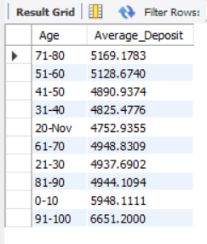

What is the average admission deposit for each age group ?
SELECT Age, AVG(Admission_Deposit) AS Average_Deposit FROM patient GROUP BY Age;

Slide 10
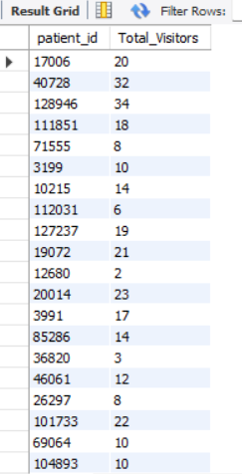

What is the total number of visitors recorded for each patient?
SELECT patient_id, SUM(`Visitors with Patient`) AS Total_Visitors FROM patient GROUP BY patient_id;

Slide 11


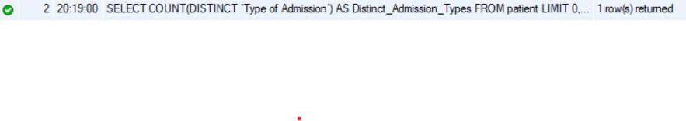
How many distinct types of admission are there?
SELECT COUNT (DISTINCT `Type of Admission`) AS Distinct_Admission_Types FROM patient;

Slide 12
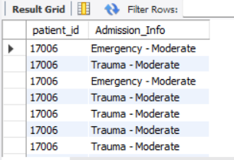
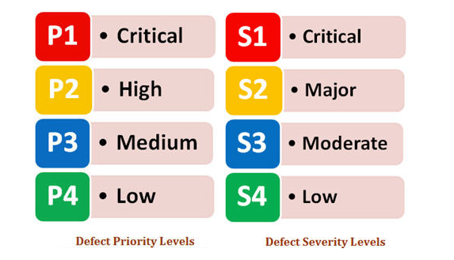
Concatenate Type of Admission and Severity of Illness into a single column named Admission_Info.
SELECT patient_id, CONCAT(`Type of Admission`, ' - ', `Severity of Illness`) AS Admission_Info FROM patient;

Slide 13

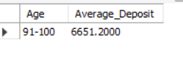
Which age group has the highest average admission deposit?
SELECT Age, AVG(Admission_Deposit) AS Average_DepositFROM patientGROUP BY AgeORDER BY Average_Deposit DESCLIMIT 1;

Slide 14
OVERALL INSIGHTS
The analysis examines patient distribution and financial deposits across hospitals and departments, revealing trends based on hospital code and department performance.
By grouping data by age and admission type, patterns in financial contributions and service utilization across different patient demographics are identified.
Variations in maximum and minimum deposits, total visitors per patient, and patients with the highest deposits provide valuable insights into financial performance and patient behavior.
Missing entries and the identification of distinct admission types emphasize areas for improving data quality and integrity.
Aggregated admission deposits by age group and admission type uncover key financial patterns, aiding in understanding demographic-specific contributions.

Slide 15
RECOMMENDATIONS
Address missing values, such as City_Code_Patient, to ensure data accuracy and completeness for reliable analysis. Reliable data will improve the quality of insights and decision-making for hospital operations.
Allocate resources and tailor strategies toward the age groups and admission types with the highest financial contributions to optimize revenue. This targeted approach can help prioritize high-value demographics.
Use insights from department-level and hospital-level patient distributions to streamline operations and balance workloads. Ensuring an even distribution of resources can improve efficiency and patient care quality.
Regularly evaluate admission types and illness severity combinations to improve patient care and financial planning. Understanding these patterns can help hospitals adjust their service offerings to better meet patient needs.

Slide 16
CONCLUSION
The project provides valuable insights into patient demographics, financial trends, and hospital performance. It highlights the importance of targeted strategies to improve operations and maximize revenue while addressing data quality issues. By leveraging the identified patterns and recommendations, hospitals can enhance decision-making, optimize resource allocation, and deliver better patient care while maintaining financial sustainability.

